Slide 1
Nmap Commands and Outputs
Presented by - Noel Varghese

Slide 2
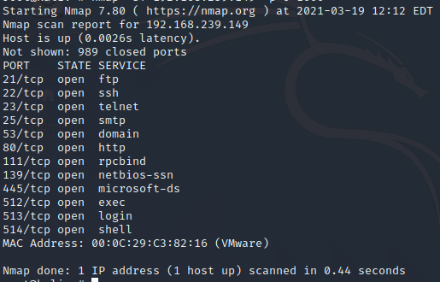
Command-1
Switches Used- -O(OS Detection) -p(Port Scanning)
Test Performed-TCP Scan
Result
Open Ports-11
Closed Ports-989

Slide 3
Command-2
Switches Used- -O(OS Detection), -oX(Save result in XML Format), -vv(Very verbose), –p (Port Scan) and -sT
Test Performed-TCP Scan
Target IP-MetaSploitable Linux

Slide 4
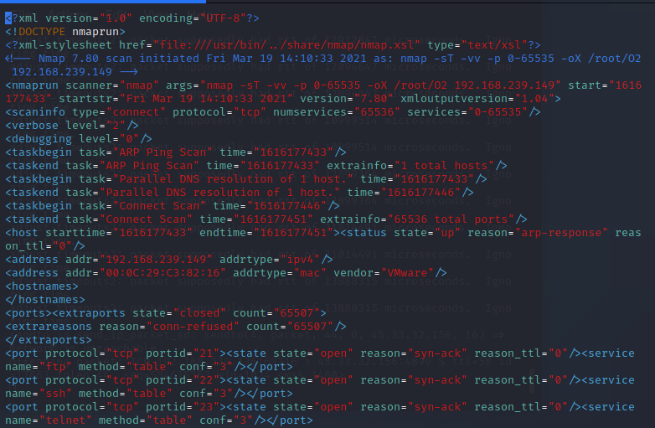
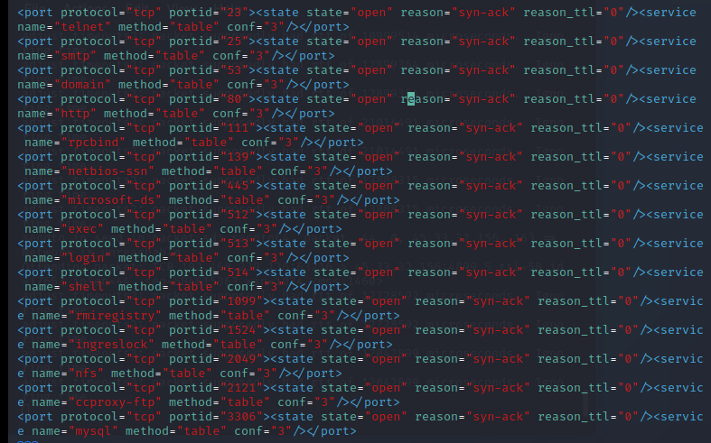
Result – Command-2

Slide 5
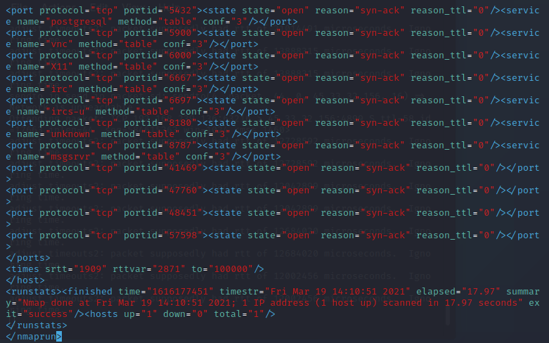
Result continuation
Result Inferences:-
Hosts Scanned-1
Elapsed time is displayed
Extra information can be obtained, such as port, port id, ttl etc

Slide 6
Command -3
Switches Used- -ss (Syn Scan), -O (OS Detection), -oX(Save result in XML Format)
Test Performed- Syn Scan
Target IP-MetaSploitable Linux machine

Slide 7
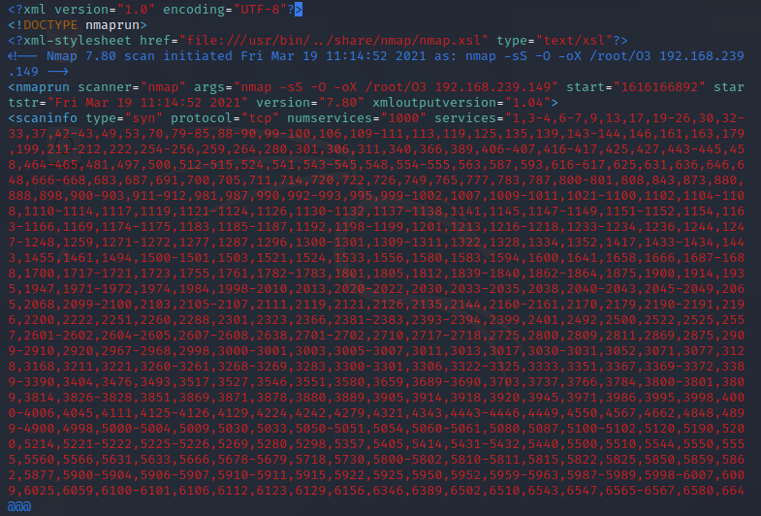
Result- Command-3

Slide 8
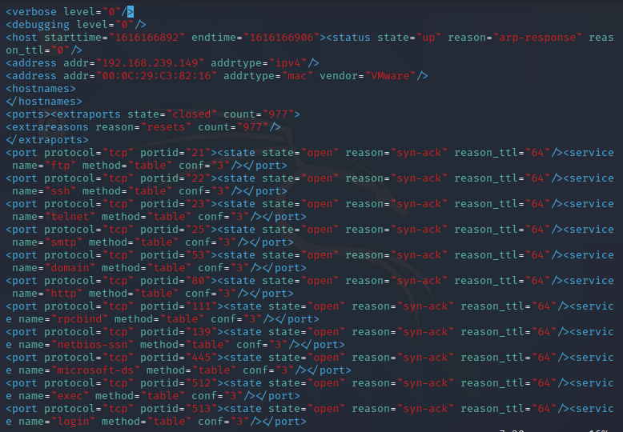
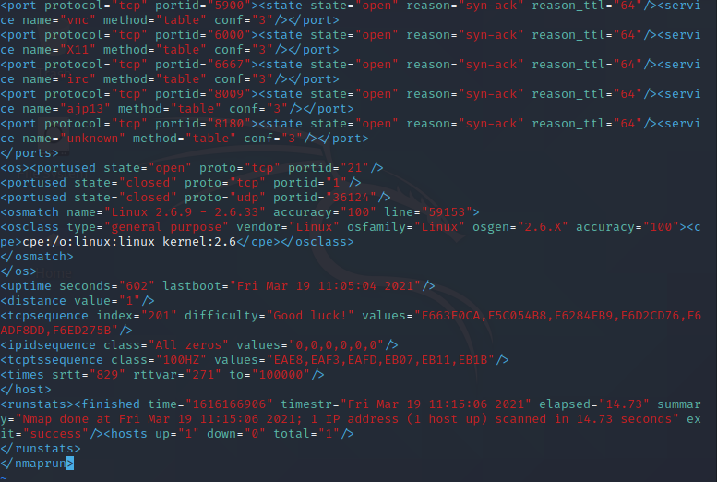
Remainder of Output (XML File)
Result Inferences:-
Nmap found that the scanned machine had the Linux 2.6.9-2.6.33 and accuaracy was 100%
It was able to find the uptime of machine and datestamp/timestamp of last boot

Slide 9
Command-4
Switches Used- -sT (TCP Scan), -A (Aggressive Scan) and –vv (Very verbose)
Test Used-TCP Scan
Target-MetaSploitable Linux machine

Slide 10
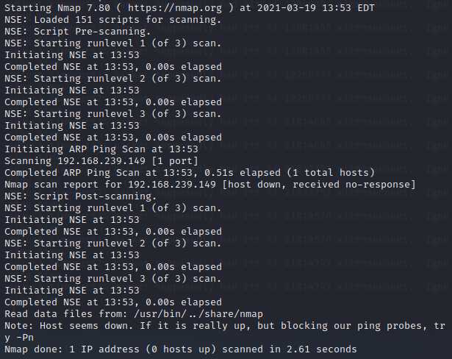
Result- Command-4

Slide 11
Command-5
Switches Used- -sU (UDP Scan), -vv(Very verbose) and-p (Port Intervals)
Test Performed- UDP Scan
Target-IP provided by nslookup scanme.nmap.org

Slide 12
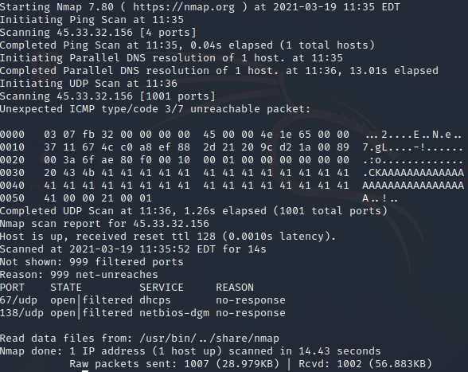
Command-5 Result
Result Inferences:-
Ports filtered by firewall-999
Ports Open-2
Services running on select
ports were found
Host is up

Slide 13
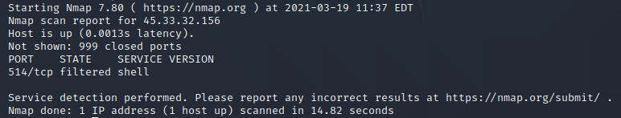
Command-6
Switches Used- -sV(Service Detection)
Target-IP provided by nslookup scanme.nmap.org
Result Inferences:-
Closed Ports-999
Open Port-1
Service Version-DD-WRT

Slide 14
Command-7
Switches Used- -sT (TCP Scan), -T1 (Time for scanning), -vv(Very Verbose)
Test Performed-TCP Scan
Target-IP provided by nslookup scanme.nmap.org

Slide 15
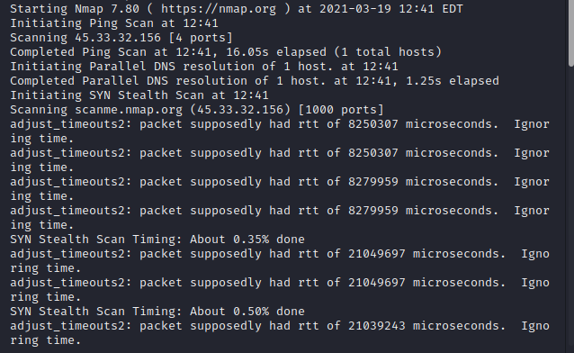
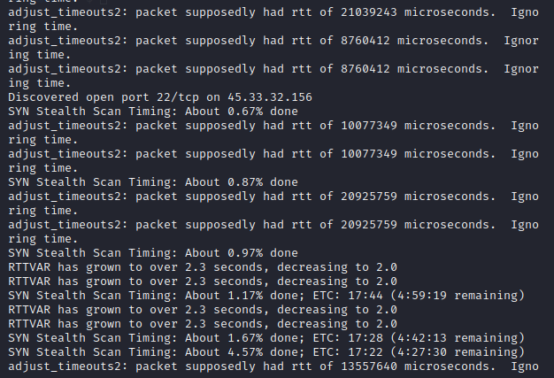
Result- Command-7 (Result Inferences)
Lengthy Scan

Slide 16
Command-8
Switches Used- -sS (Syn Scan), -A(Aggressive Scan)
Test Performed-Syn Scan
Target-IP provided by nslookup scanme.nmap.org
Aggressive Scans can reveal more information about target,akin to -vv

Slide 17
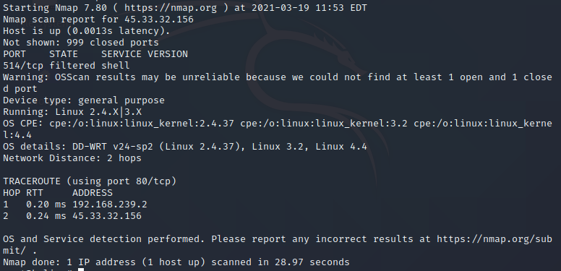
Output – Command-8
Result Inferences:-
Closed Ports-999
Open Ports-1
Service Detection and
OS Detection were performed
Service-General Purpose
Target OS Type-Linux
Performed 2 hops (path between
attack and target machine)

Slide 18
Command-9
Switches Used- sX(Xmas Scan) , -oN (For saving scan result in normal form)
Test Performed-Xmas Scam
Target-MetaSploitable Linux machine

Slide 19
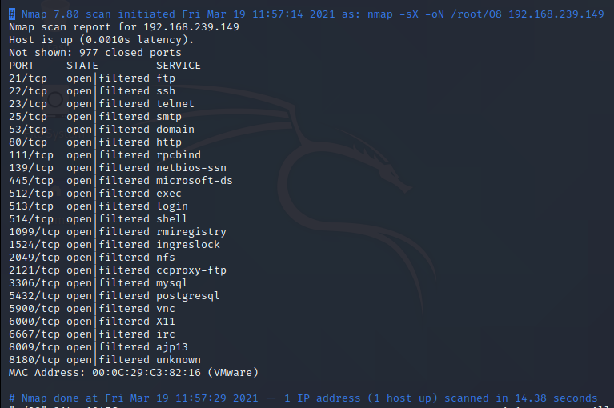
Output-Command 9
Result Inferences:-
Closed Ports-977
Opened Ports-23
Host is up
Services are present on each
open port
Linux Machines accept
Xmas Scans.Wndows OS,does
not.

Slide 20
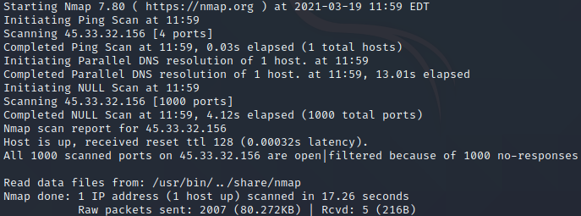
Command-10
Switches Used- -sN (Null scan), -vv(Very verbose)
Test performed-Null Scan
Target IP-Provided by nslookup scanme.nmap.org
Result Inferences:-
Host is up
All ports are open|filtered, by
Firewalls.We do not know if ports
are opened or filtered.

Slide 21
The End

